Slide 1
React JS Components

Slide 2
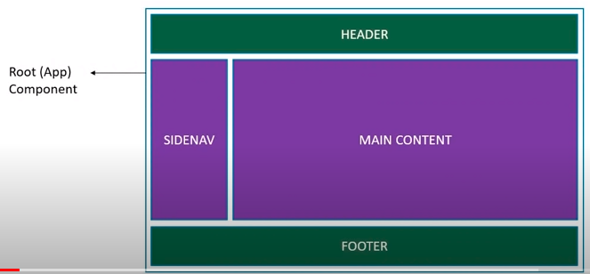
Components are like functions that return HTML elements.
Components are independent and reusable bits of code. They serve the same purpose as JavaScript functions, but work in isolation and return HTML.

Slide 3
Components come in two types :
Class components
Function components
Create Your First Component
When creating a React component, the component's name MUST start with an upper case letter.

Slide 4
Class Component
A class component must include the extends React.Component statement. This statement creates an inheritance to React.Component, and gives your component access to React.Component's functions.
The component also requires a render() method, this method returns HTML.
import React from 'react';
class Welcome extends React.Component {
render() {
return <h2>Hi, Welcome to React JS!</h2>;
}
}
export default Welcome;

Slide 5
Function Component
Here is the same example as above, but created using a Function component instead.
A Function component also returns HTML, and behaves much the same way as a Class component, but Function components can be written using much less code, are easier to understand
import React from 'react';
function Welcome() {
return <h2>Hi, Welcome to React Function Components!</h2>;
}
export default Welcome;

Slide 6
Rendering a Component
Now your React application has a component called Car, which returns an <h2> element.
To use this component in your application, use similar syntax as normal HTML: <Welcome />

